Slide 1
Governments-AP Comp
From Democratic to Authoritarian

Slide 2
#1 Great Britain
Some free elections
Some human rights
Some rule of laws
Some free market economies with big GDPs
Have party competition
Some peaceful transitions
Ways to check power within the government
Have civil society and bring people together with gov
Ways to hold elected officials accountable

Slide 3
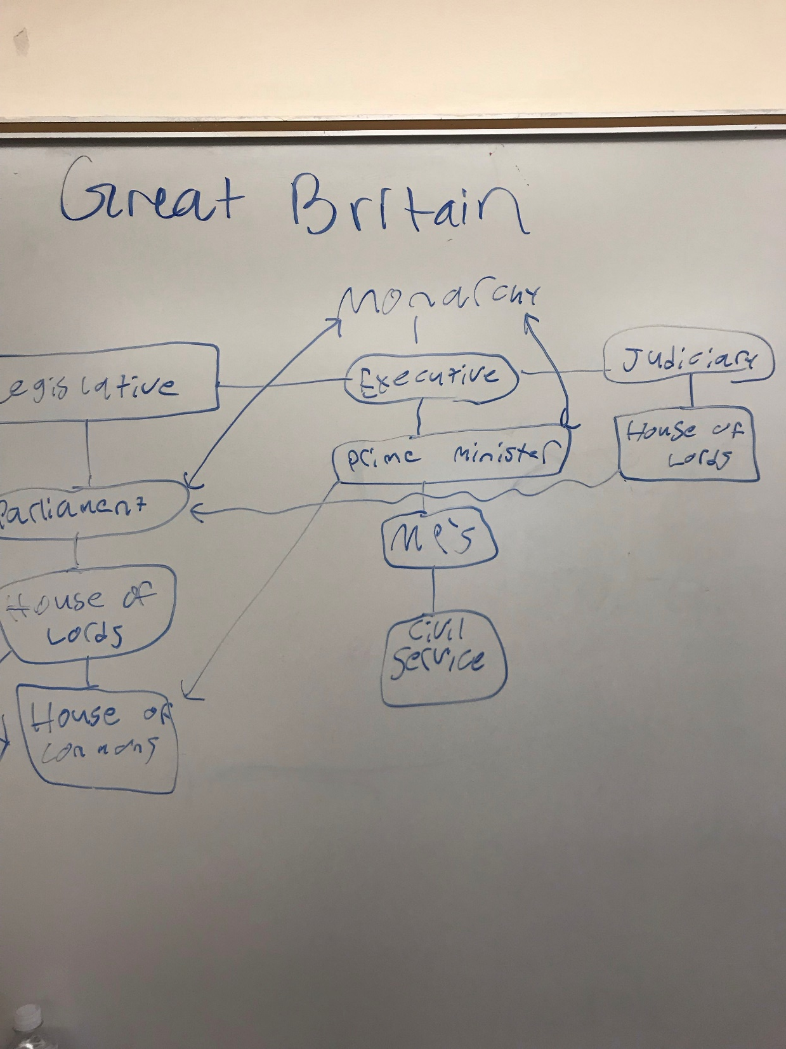

Slide 4
#2 Mexico
Competitive elections
Political parties (5 or so)
On paper they have free speech—they do but it’s deterred because of cartels and crime
President is elected to 1-- 6 year term by popular vote
Legislative branch elected by popular vote and proportional reps
Supreme court only has 1 term of 15 years
Checks and balances (judicial appointees confirmed by congress)
Corruption and political violence are a problem
Police brutality happens

Slide 5
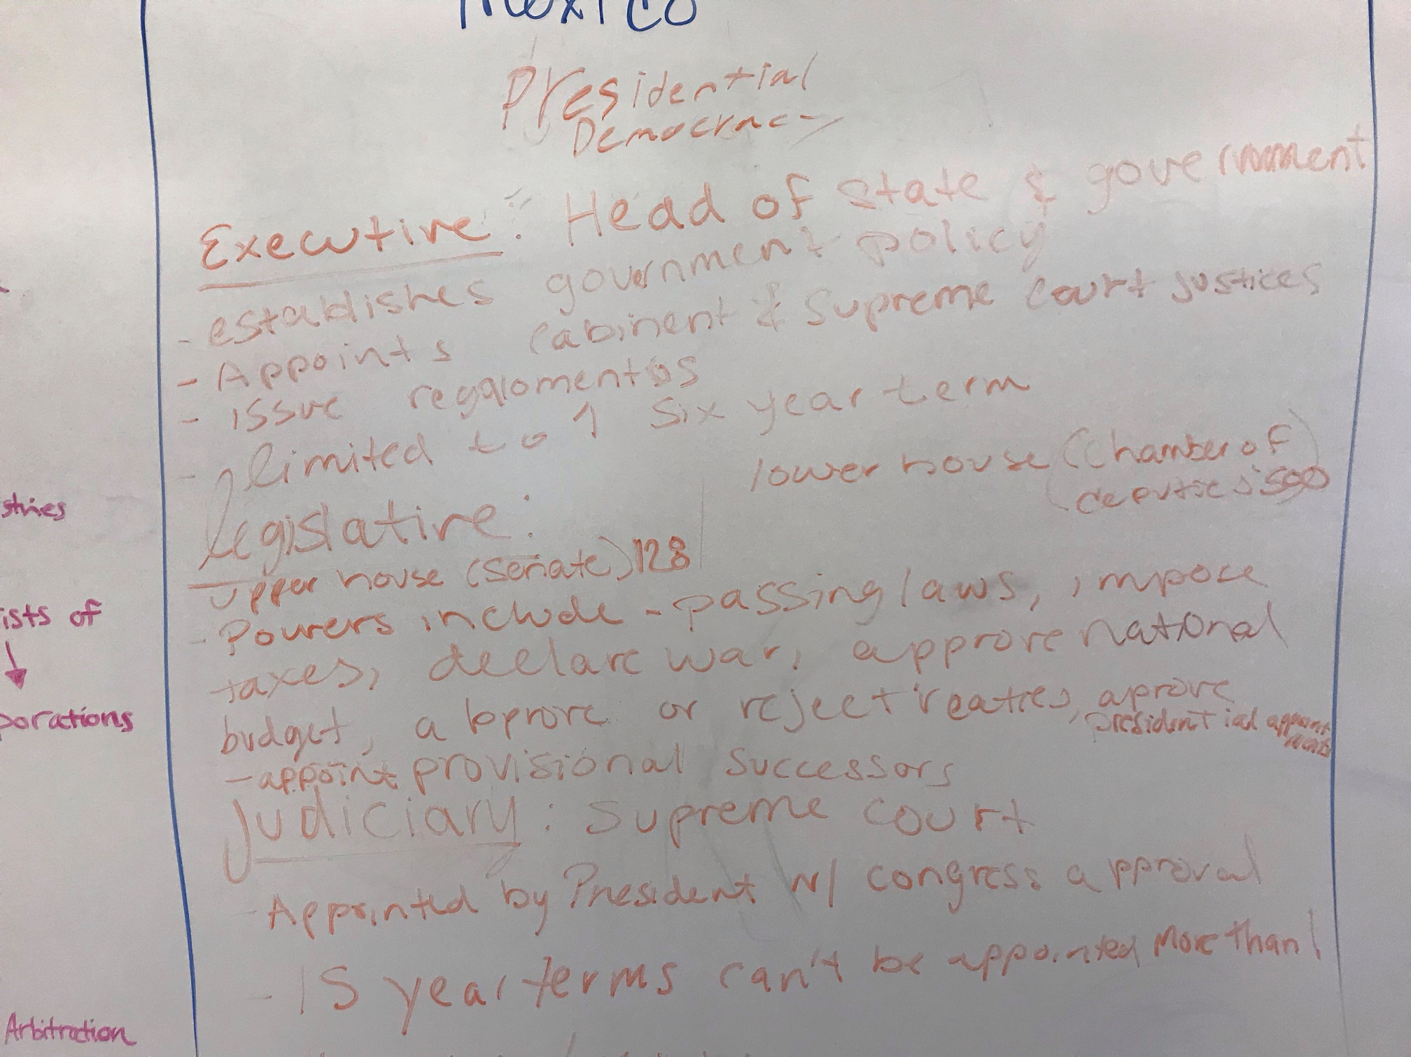

Slide 6
#3 Nigeria
It looks democratic on paper, implementation it gets grey
Elections are “competitive” but actually deterred by violence and intimidation and polling issues. Voter turnout is really bad.
There have been peaceful transitions of power (but haven’t been many transitions)
There are multiple political parties but it’s hard to compete against the major ones (Peoples Democratic party in power from 1999-2015)
Economy is supposed to by “mixed” but there is a lot of government corruption due to reliance on oil=excessive government involvement and economy not really free
Civil society exists and functions for a while, but at the same time not a lot of public is involved/popular.
House and senate proposing bills to limit civil society….. (in process?)
Buhari has been violating checks and limits on government (imprisoning judges, raiding senators’ houses without much of explanation, intimidation)
Freedom of speech and press violated (journalist and activists imprisoned)
Social media attempted to restrict (by Buhari) but was stopped
Boko Haram is greatly affecting who’s actually able to vote
Is ability to vote people out of office, but limited
Rule of law exists, but judicial branch does not function independently and without corruption. (pubic officials often not subject to authority)

Slide 7
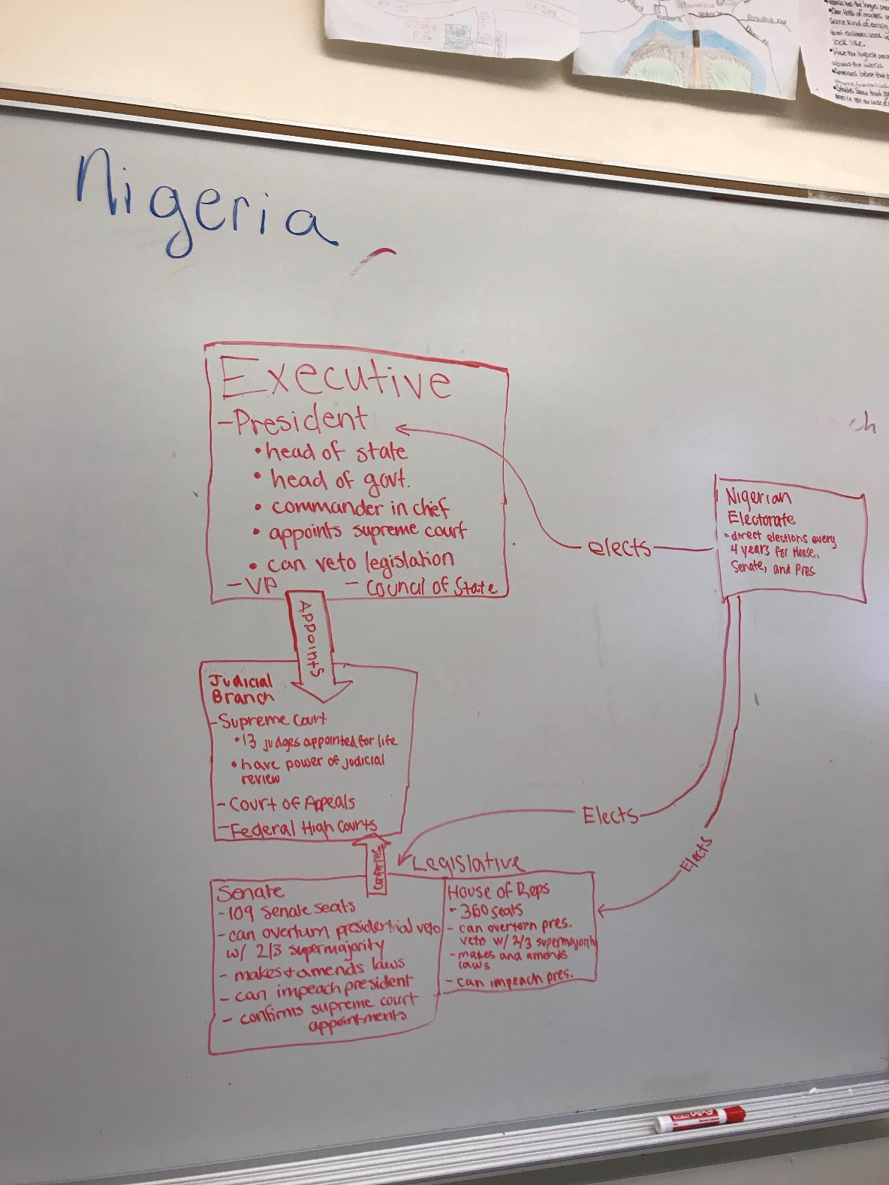

Slide 8
#4 Russia
Democratic on paper
Have laws for free speech and press, but Putin and government deny broadcast licenses, arrests journalist and sometimes kills them
Forces companies to sell self to state
Technically have voting rights, but restrictions on media mean campaigning doesn’t really exist (no opposition candidates)
Fair elections not possible
Totalitarianism? Basically. Putin installs allies for government positions
Fake democracy but looks like republic with three branches
Opposition is hand picked by Putin. (looks more democratic, without risk of real opposition—he manipulates to look like a democracy)
After USSR fell, Russia feared checks and balances would endanger ability for top-down reform.

Slide 9
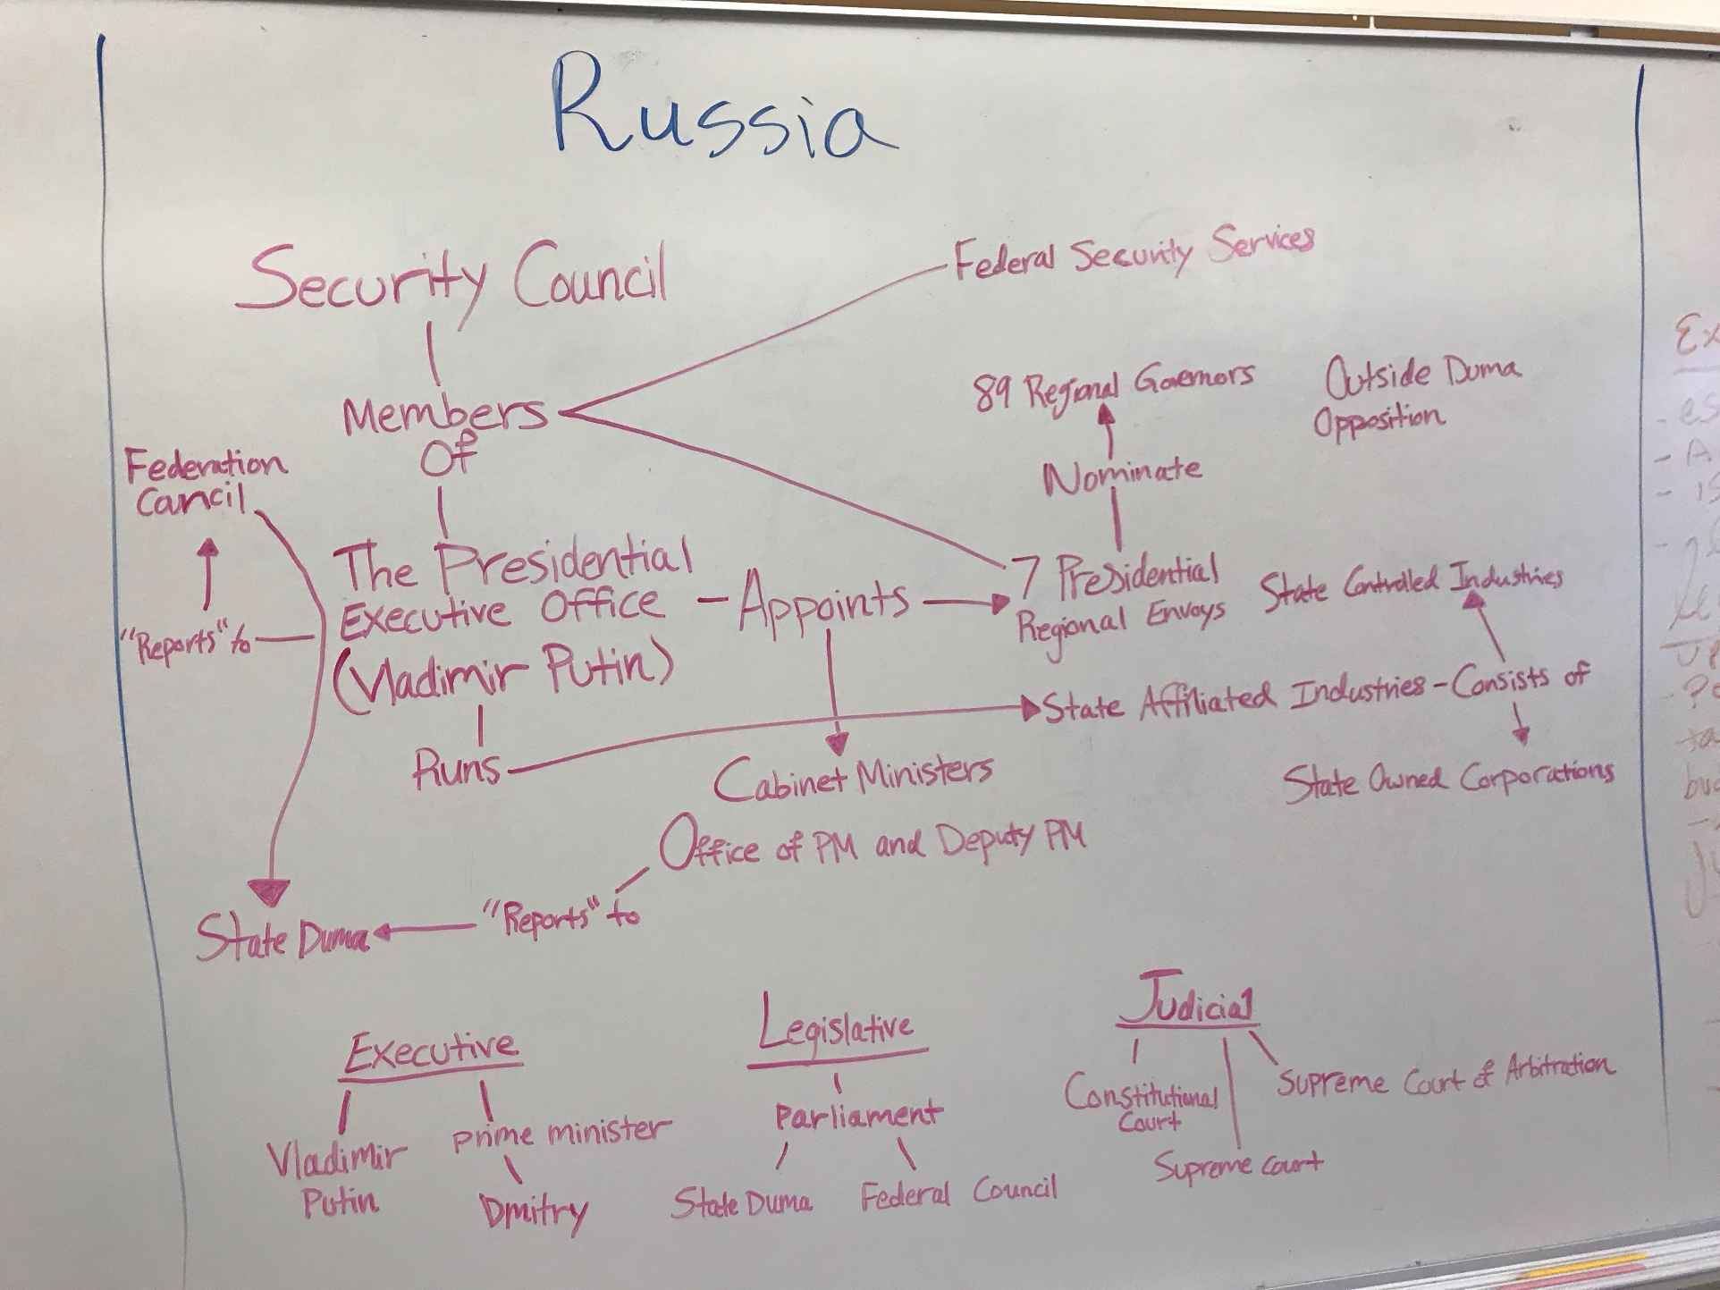

Slide 10
#5 Iran
In terms of government –structure might appear democratic with checks and balances and legislature that can pass laws
But supreme leader (SL) either approves candidates for leg. Or appoints people to approve—power to do anything is beholden to the SL.
The only democratic element is the peaceful transition of power (Khomeini to Khamenei). Don’t happen very often
Presidency change not real change of power
Elections are not free fair or competitive. People can vote, but very few candidates are approved (and parties) of 1600, approved 6 in last election. (fake choice-status quo is preserved) Also claims of elections being rigged (2009)
Media is heavily censored (govt monopoly on broadcasting) and satellite dishes are banned
Demonstrations allowed only in accordance with Islam, in practice only demonstrations that support government allowed
Activists, foreigners subject to arbitrary prosecution and detention limited independence.
Judiciary upholds law but is also tool of government oppression
Mixed economy, however government controls petroleum industry (most important). Smaller companies are funded or controlled by government of Rev Guard.

Slide 11
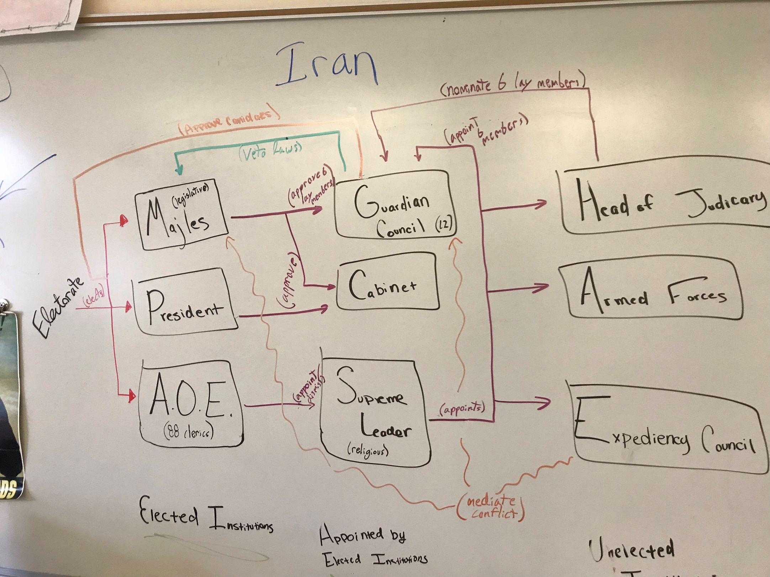

Slide 12
#6 China
Led by communist party, all people who run for election are from that party
No free and competitive elections
President elected by NPC, but people of China don’t elect NPC (hierarchy) really no way for people to challenge the top.
In order to be considered from NPC, you have to be approved by people already in power (so no opposition)
No civil liberties (censors internet, news, all of those, everything is state run, no private media companies)
Those who speak against government are punished, killed, arrested, camps
Prevalence or rule of law—doesn’t really happen (many class systems in place)
Govt allows opposition movements, but controlled by government

Slide 13
